Slide 1
Launch Event
Wednesday 24th February 2021
Notes:
.

Slide 2
A Very Warm Welcome
From the Incubator event team
Gillian Vance
Janice Ellis
Bryan Burford
Diane Livingstone
Our co-hosts
Edit your zoom name to show your full name and organisation
Audience interaction – essential!
Encourage use of chat box for asking questions
Please do tweet from the main session
Notes:
.

Slide 3
Agenda
12.50-13.00 | Sign in and get settled
13-13.15 | Welcome, Introductions & The Vision
13.15-14.00 | Key note lectures Professor Dave Jones OBE, Dean for the NIHR Academy Professor Anne-Maree Keenan OBE, Associate Dean for the NIHR Academy Dr Karen Fernando, Assistant Director of Infrastructure and Capacity Building Structures for the NIHR Academy Richard Milham, Programme Manager Integrated Pathways,
14.00-14.10 | What do we mean by ‘Clinical Education Research’?
14.10-14.35 | ClinEdR in 2021 – where are we now?
14.35-15.15 | Break Out Discussions ClinEdR in 2024, and beyond Where do we need to be? How do we get there?
15.15-15.25 | Stretch your legs and grab a coffee
15.25-15.55 | Sharing break out thoughts and ideas
15.55-16.00 | Next steps and Close of Meeting

Slide 4
Co-hosts and ‘story tellers’
Julian Archer Australia
Megan Brown Hull-York
Oliver Burton Keele
Sonia Bussey Newcastle
Daniele Carrieri Exeter
Richard Conn Belfast
Michael Escudier London
Gabrielle Finn Manchester
Simon Fleming London
Gary Frost London
Julie Green Keele
Karen Mattick Exeter
Sandra Nicholson London
Sophie Park London
Alison Pooler Keele
Eliot Rees Keele

Slide 5
Why are we here, and why now?
‘training is patient safety for the next 30 years’ (Temple, 2010),
Healthcare landscape is changing –
Patterns of health and disease
Technological and therapeutic advances
Systems of care delivery
Research into, and informing, changing needs/delivery of training is central to safe and sustainable NHS
Anticipate, and solve practice challenges

Slide 6
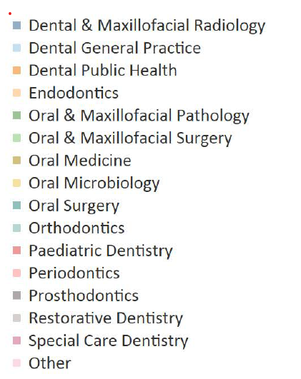
Academic Workforce – the leaking pipeline
MSC survey 2019 | Number of WTE, all grades, 2019
Physicians / Medicine | 2104.7
Oncology | 325.7
Paediatrics & Child Health | 309.4
Medical Education | 46.9
Early
Mid
Senior
DSC survey, 2019
NEJM, 1979

Slide 7
Our Vision
‘To lead a strategic expansion of career researchers in clinical education, driving processes and culture change in order to position educational research as an esteemed career destination’.
‘Dare mighty things’…

Slide 8
Incubator Framework
Hub of a national research community
Inclusive
Representative
Advisory Group
Workstreams
Peter Yeates, Gabrielle Finn, Alison Pooler, Karen Mattick

Slide 9
Goals
Website:
https://research.ncl.ac.uk/clinical-education-research-incubator/
Twitter: @ClinEdResearch
Email:
clinical.education.incubator@newcastle.ac.uk
Amplify impact
Enable success
Increase awareness

Slide 10
Agenda
12.50-13.00 | Sign in and get settled
13-13.15 | Welcome, Introductions & The Vision
13.15-14.00 | Key note lectures Professor Dave Jones OBE, Dean for the NIHR Academy Professor Anne-Maree Keenan OBE, Associate Dean for the NIHR Academy Dr Karen Fernando, Assistant Director of Infrastructure and Capacity Building Structures for the NIHR Academy Richard Milham, Integrated Pathways, Programme Manager
14.00-14.10 | What do we mean by ‘Clinical Education Research’?
14.10-14.35 | ClinEdR in 2021 – where are we now?
14.35-15.15 | Break Out Discussions ClinEdR in 2024, and beyond Where do we need to be? How do we get there?
15.15-15.25 | Stretch your legs and grab a coffee
15.25-15.55 | Sharing break out thoughts and ideas
15.55-16.00 | Next steps and Close of Meeting
Notes:
.

Slide 11
Thank you for attending
Conversation will continue!
Email: clinical.education.incubator@newcastle.ac.uk
Interactive webinar for career researchers – coming soon!

